Slide 1



SOUTH CENTRAL RAILWAY
HYDERABAD DIVISION
Inauguration of Smart Pumping System
at Sheepmandi
By
Shri Arun Kumar Jain
General Manager, South Central Railway
On 02-07-2024

Slide 2
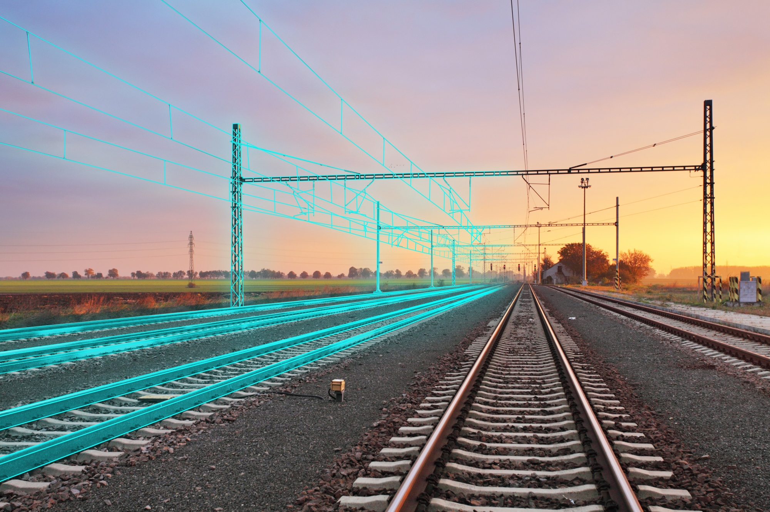
IoT Solutions for Non-traction Railway assets
(IR-NIYANTRAC)

Slide 3
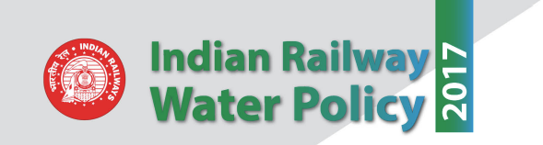

Key Driver
Create Water Management Plan (WMP) – Demand and Supply Side Management
Introduction of Automatic Valves
Use of SCADA based control systems
Phasing out of valveman
Measurement and Accountability of Water Consumption
Target: 20% efficiency in water use by 2030

Slide 4

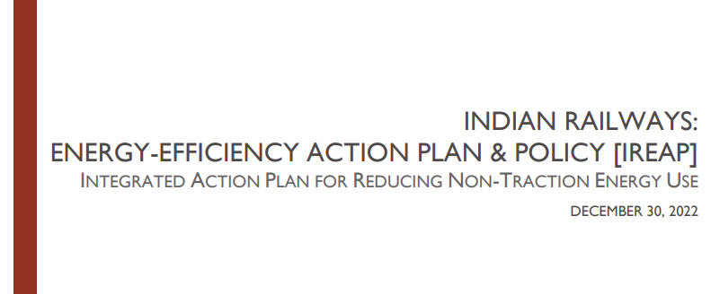
Key Driver
As a fallout of COP 28 meet at Dubai, Govt of India resolved to meet the 40% REDUCTION OF EMISSION by 2030
Govt of India identified Indian Railways as one of the sectors
Indian Railways (through CRIS) designed a IoT Platform IR-NIYANTRAC, a platform to which all the data shall be uploaded to centrally monitor all non-traction assets of all Zones
Target: 40% EMISSION REDUCTION BY 2030

Slide 5
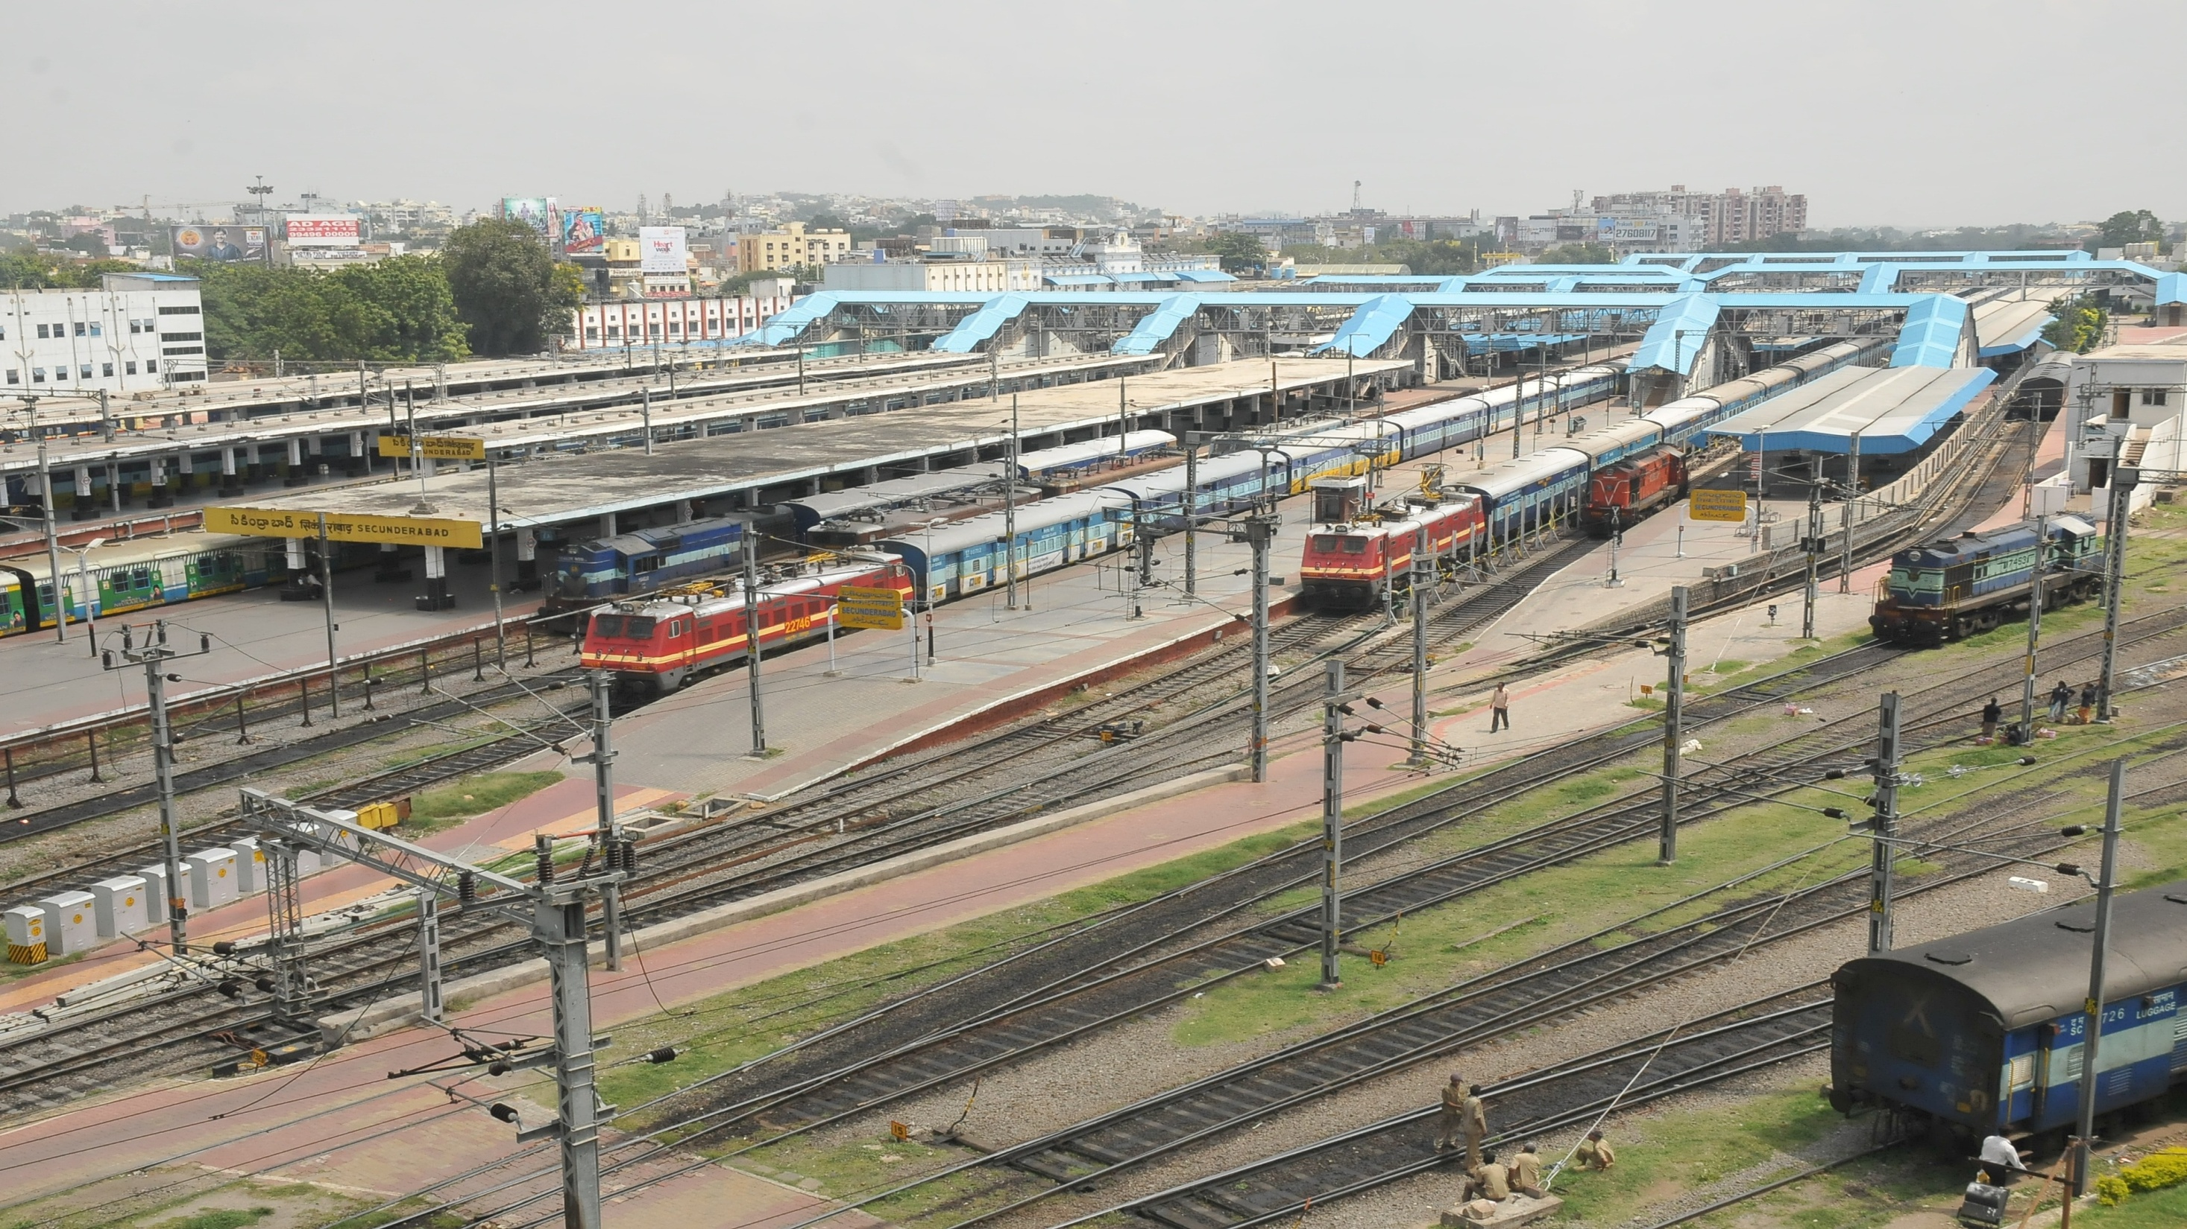
IoT SOLUTIONS
at Hyderabad Division
(Sheepmandi Pumphouse, Kacheguda Station )

Slide 6
Objectives of Sheepmandi Pumphouse Upgradation
Energy Saving by replacing centrifugal pumps with efficient submersible pumps
Real time monitoring and accountability of water distributed and reducing water wastage or unaccounted for water.
Remote control of valves, thereby eliminating the need for manual intervention by valve operators.

Slide 7
Before IoT intervention
Sheepmandi storage sump has 40 KL capacity. Manually operated valves, motors. No level gauges, no flow gauges
Expenses per month
Water from GHMC @ Rs. 1.90 Cr
Power bills @ Rs. 3 lakhs
Manpower @ Rs. 2 lakhs

Slide 8
After IoT intervention
Replaced with efficient VVFD driven submersible pumps
Manual Valves replaced with valve actuators for automation
Level sensors in all reservoirs
Flow meters deployed to measure water quantity
Intelligent Field Device for onward link to mobile app/IR NIYANTRAC
A mobile app to
Operate and control motors, valve actuators
Monitor electrical and water parameters
Notifications to O&M staff
Analytics dashboards
Savings on energy, water (expecting 10-15% saving)

Slide 9
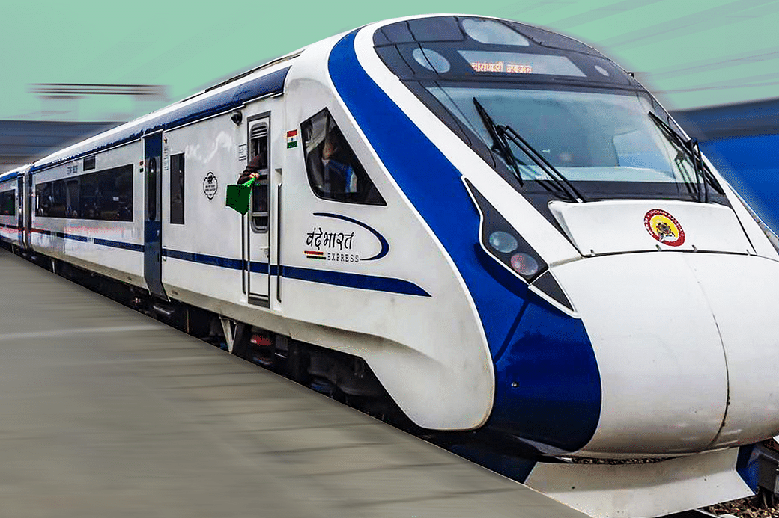

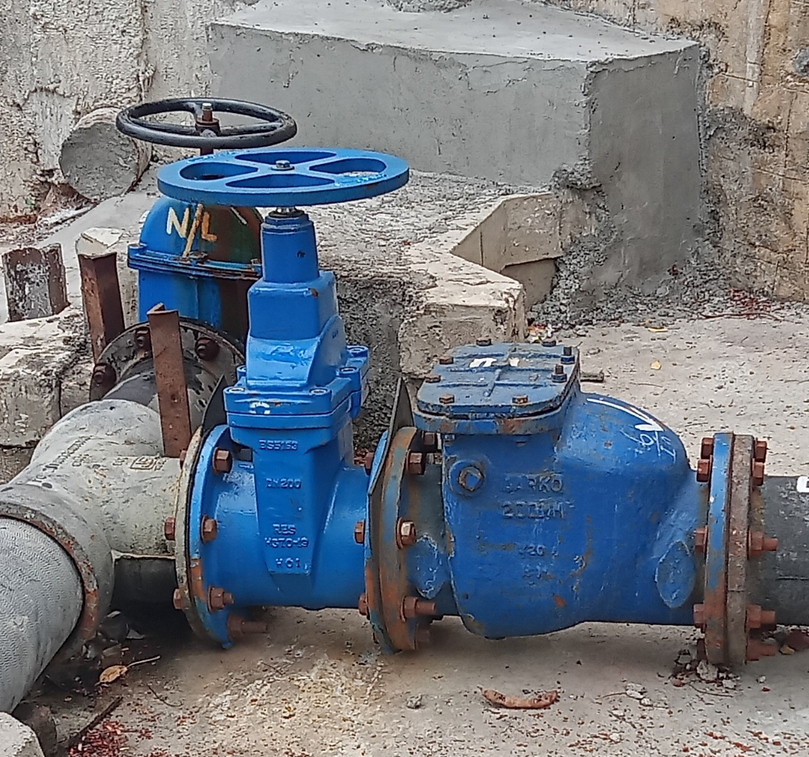
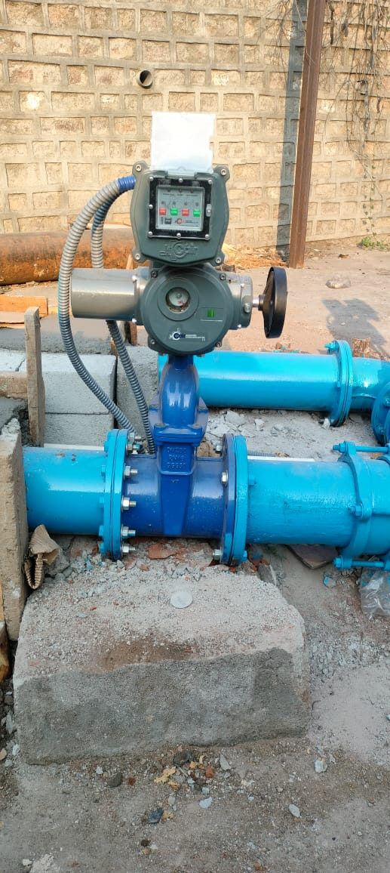
Before
After
Manual Sluice Valve
Valve Actuators for remote ON/OFF
9

Slide 10
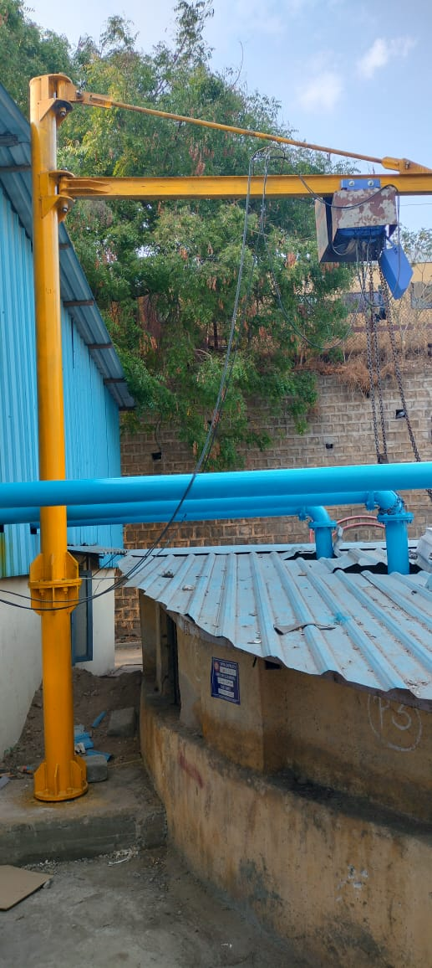
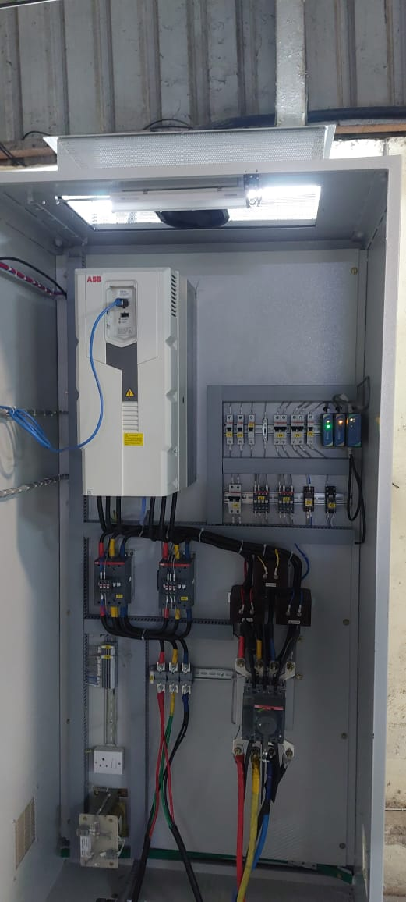
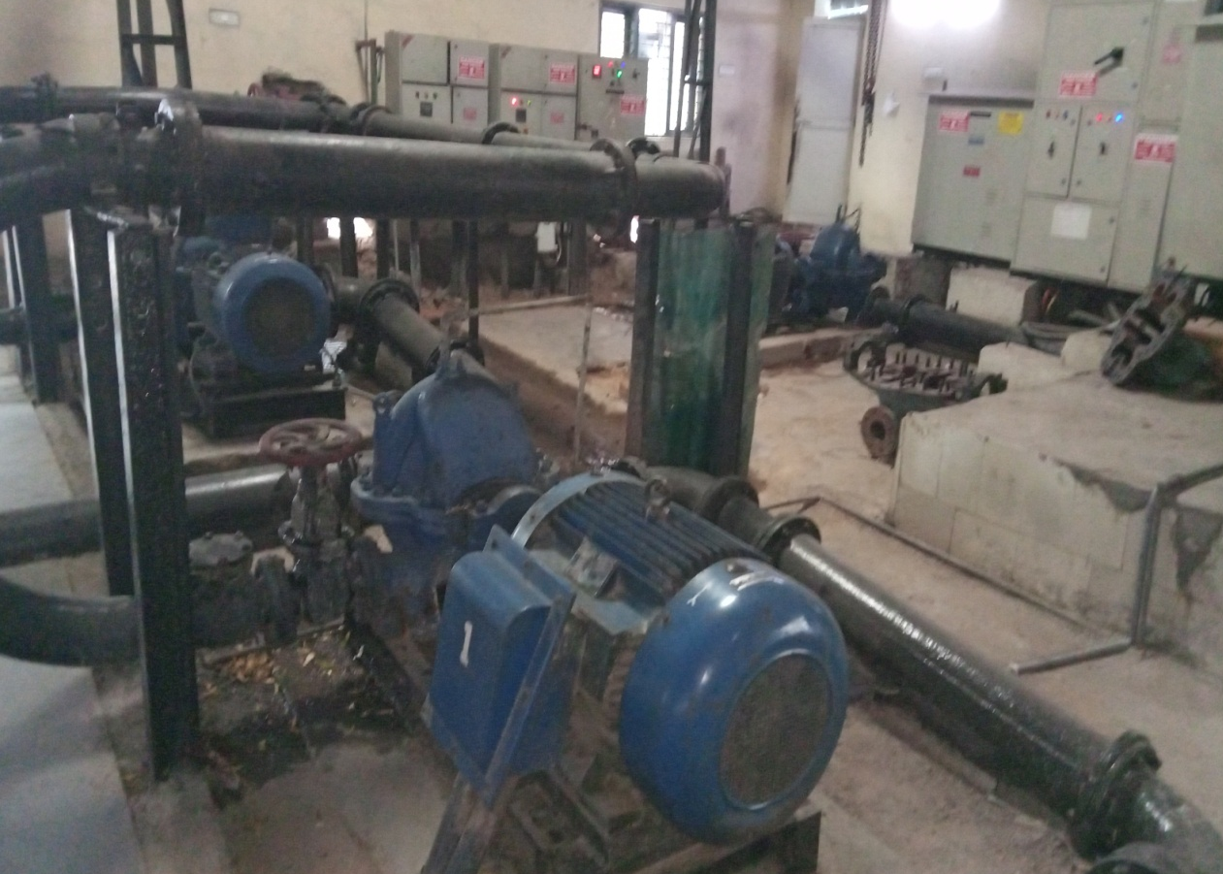
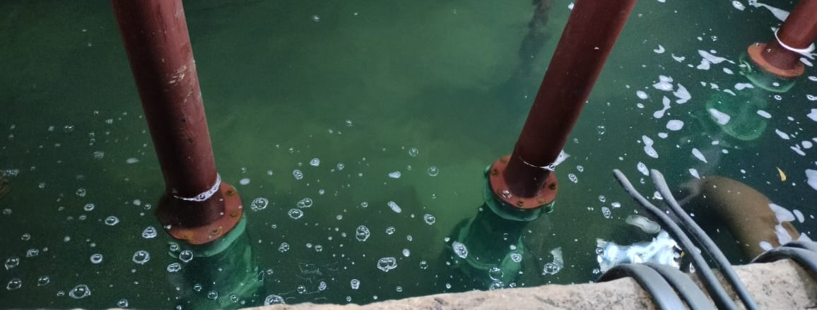
Before
After
Jib-Crane
VVFD Panel
Centrifugal Pumps
Submersible pumps
10

Slide 11
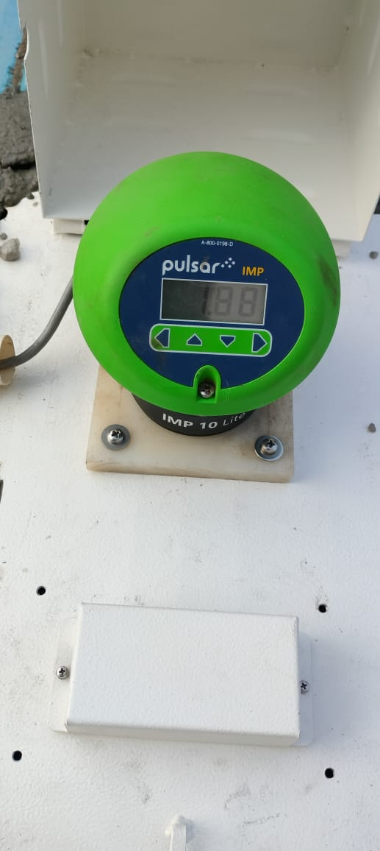
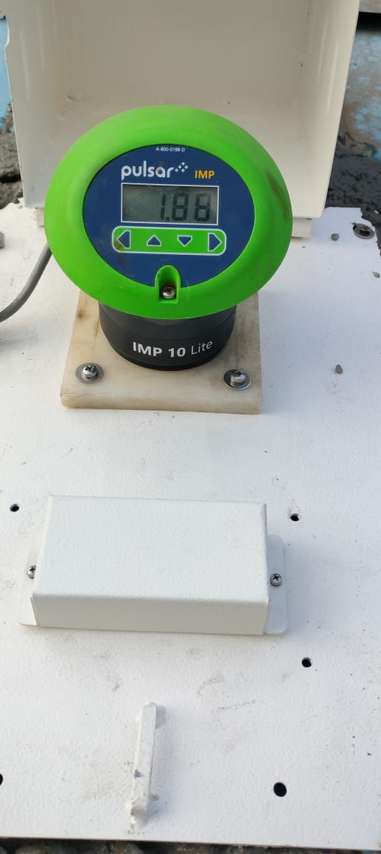
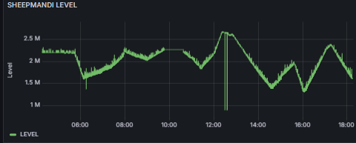
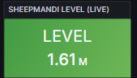
Installation Photos: Ultrasonic Level Sensors
Installation of Ultrasonic Level Meters at sheep mandi
Live Data on Dashboard
EMERGING RAILWAYS ….STEAMING AHEAD
11

Slide 12
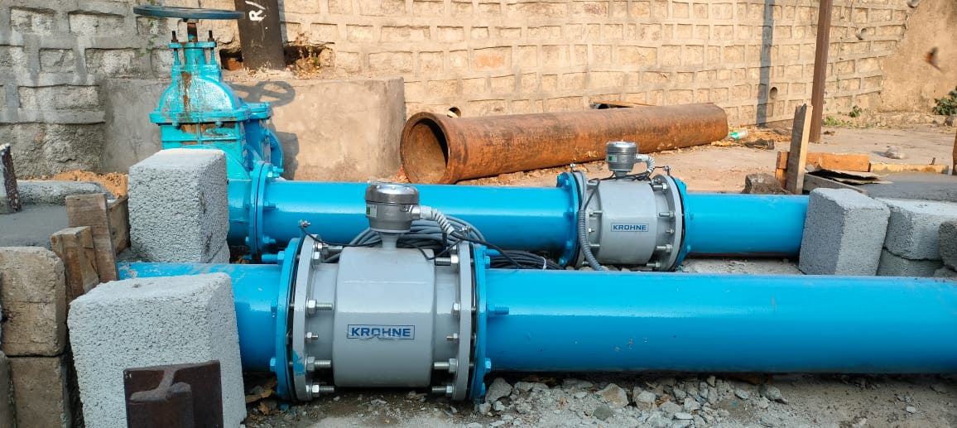
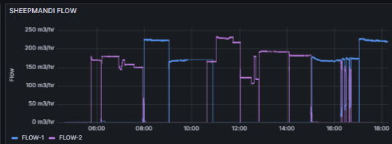
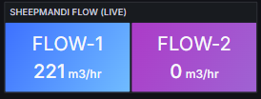
Installation Photos : EM Flow meters
Installation of Electromagnetic Flow Meters at sheepmandi
Live Data on Dashboard
EMERGING RAILWAYS ….STEAMING AHEAD
12

Slide 13
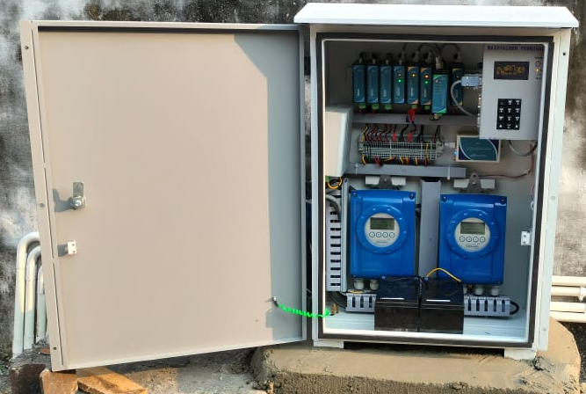
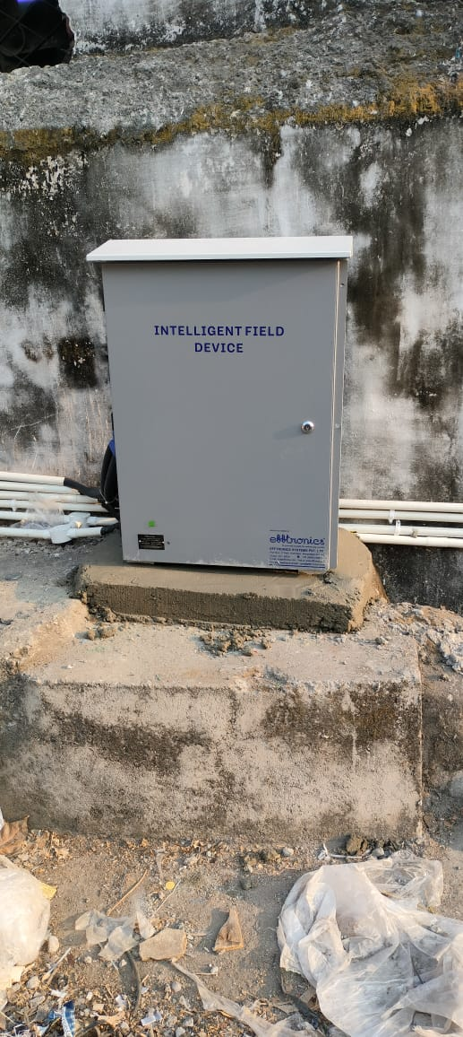
Implementation: IFD

Slide 14
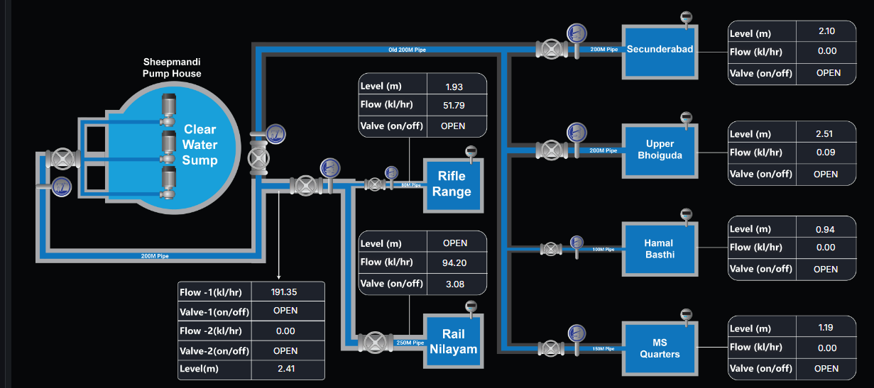
Sheepmandi – Mimic

Slide 15


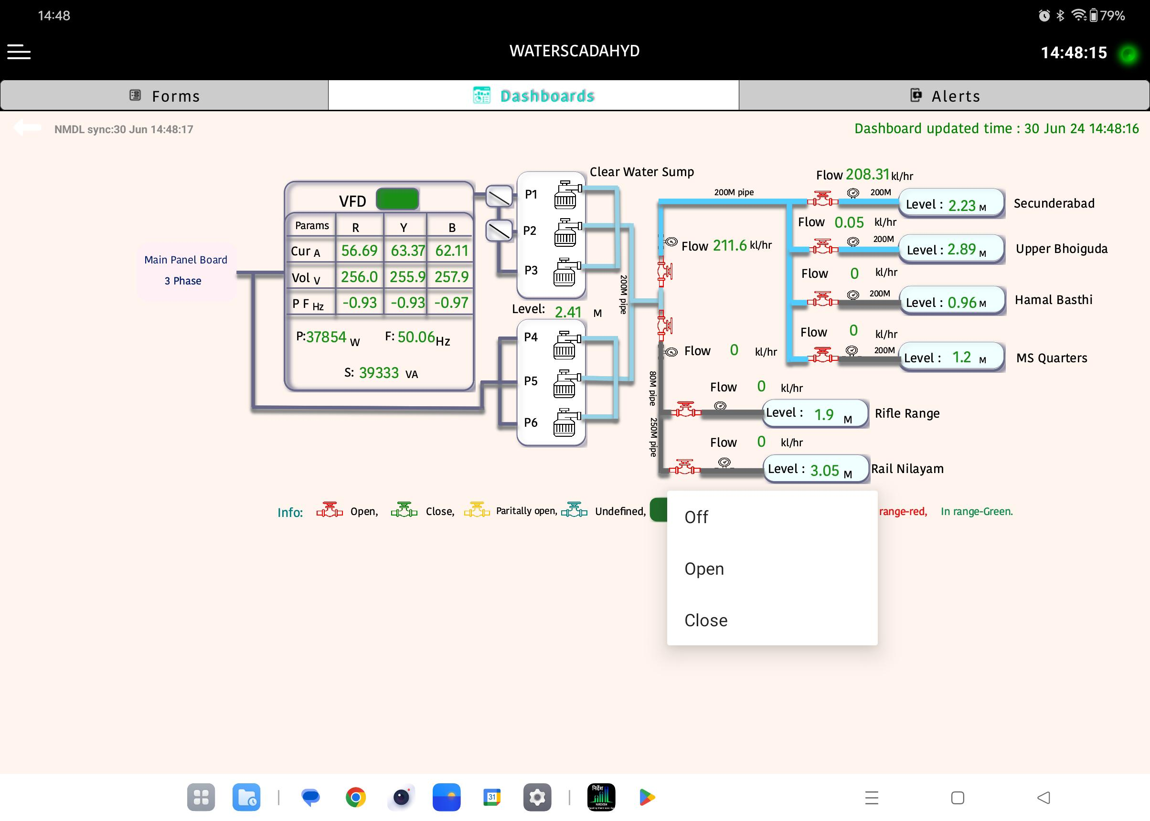
Implementation : Mobile based Pump/Valve Monitoring & Control
On track toward DIGITAL INDIA
15

Slide 16
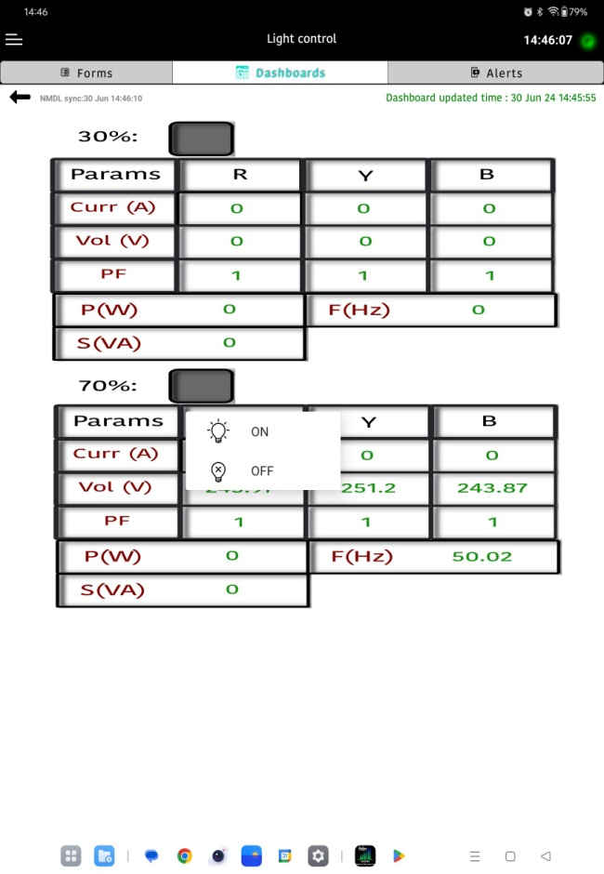
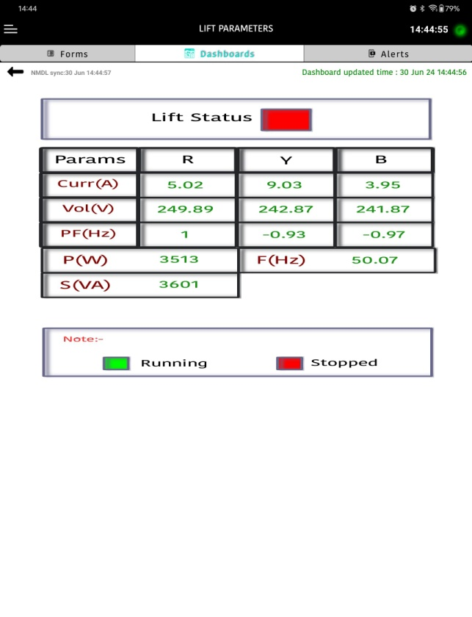
Implementation: 30-70% Lights Monitoring & Control, Lift Monitoring
(Kacheguda Station)
30%-70% Lights ON/OFF
Lifts Status
30-70% Lights
On track toward DIGITAL INDIA
16

Slide 17
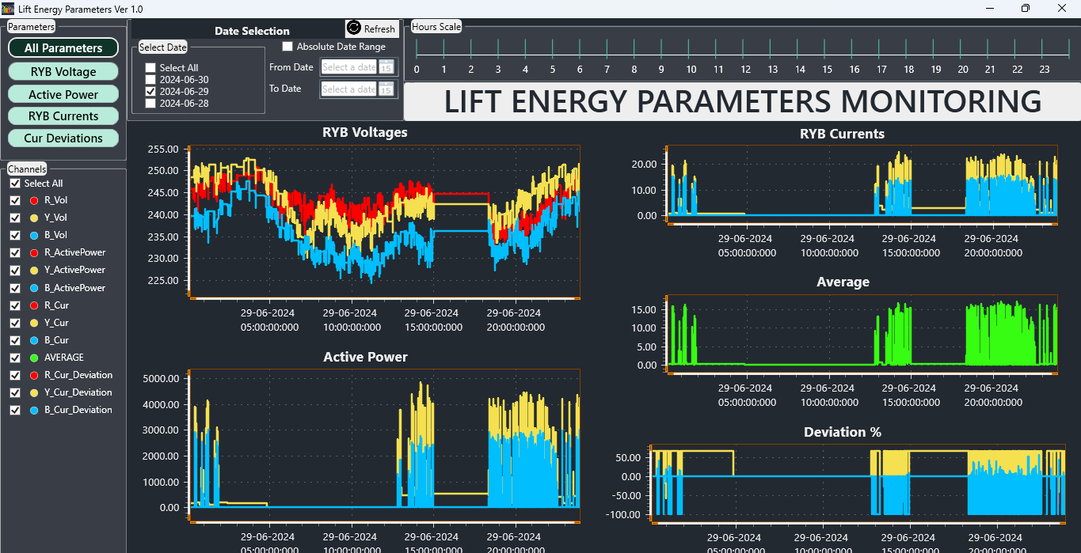
Implementation: Lift monitoring reports (Kachiguda Station )
Reports :
Energy Parameters
Operation Duration
Operation Time
On track toward DIGITAL INDIA
17

Slide 18
Value Outcomes
Monitoring & Control
Pumps
Valve Actuators
Lights
Monitoring of Lifts/Escalators
Integrable to IR-NIYANTRAC
Allied benefits such as reduced manpower, Energy saving and creating analytics

Slide 19
Sri ARUN KUMAR JAIN
GM/SCR
Sri P.D. MISHRA
PCEE/SCR
Sri LOKESH VISHNOI
DRM/HYB
Sri B.M.MEENA
CESE/SC
Sri M.GOPAL
ADRM/I/SC
Thank You
Sri P.PREM
SSE/EM/CKL
Sri VISHNU
DEN/Est/HYB
Sri ANAND
SSE/IOW/CKL
Sri SHASHANK
DEN/SC
Sri A.K.SINGH
CPM/GS/HYB
Sri M.A.RAHMAN
ADRM/HYB
Sri MUTHYALA NAIDU
Sr.DEN/Co-Ord/HYB
&
M/s. Efftronics Team

